Slide 1


Putting America’s Future in the Crosshairs
Is Your Future Looking Up?
CollegeSKY
More Efficient & Lower Cost Access to Education & Training
Better Connections Between Employers and Colleges

Slide 2




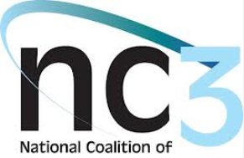

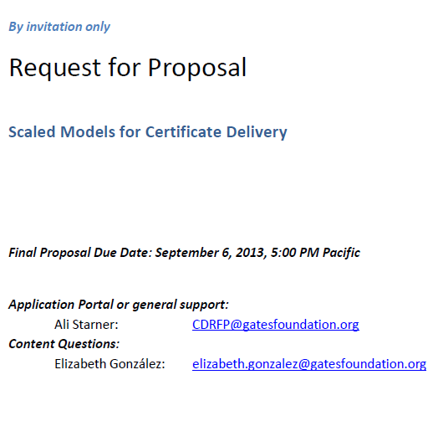
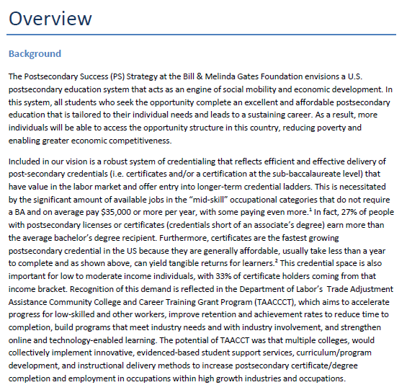
CollegeSKY
CollegeSky.com Gates Foundation RFP Invitation

Slide 3
CollegeSKY
CollegeSky.com What the Foundation Wants
The foundation seeks to better understand the potential of shared learning outcomes, common instructional content, public-private partnerships, and any other key elements, in unlocking the potential for effective delivery of industry-recognized credentials at scale. At the conclusion of this grant period, we will have a portfolio of business plans/proposals that lay out diverse approaches for joint credential delivery that provide employers with the skilled workforce they need AND provide the learner with the opportunities to build from these certificates toward their ultimate postsecondary and career goals. Furthermore, we would like to learn from the field if it is possible to create delivery models that allow for sharing across geographies and potentially diverse range of educational providers, thereby minimizing duplication of effort and resources, increasing portability of postsecondary and employer credentials, ultimately increasing progression up the rungs of career ladders.

Slide 4
CollegeSKY
CollegeSky.com Major Questions of the Foundation
Major questions the foundation is asking:
How are institutional agreements reached across sectors regarding learning outcomes, content, and credential portability?
Can costs be shared across institutional lines successfully?
What are the roles and responsibilities of involved partners?
Our objective is to learn where this kind of public-private partnership is already happening, has the potential to succeed and is doing so with broad geographical reach.

Slide 5
CollegeSKY
CollegeSky.com Foundation Interest in Partnerships
This RFP is not intended for single institution/siloed approaches to credentialing but is intended to support multi-sector public-private partnerships (with an identified lead organization) which are active in the development of certificate programs (including online), have well developed alliances among industry, community colleges and other educational providers, and technology service providers that may be activated easily in a design process.
We are especially interested in industry/employer led efforts that are already demonstrating interest in scaling effort regionally (this includes municipalities, within states, across states) or nationally.

Slide 6
CollegeSKY
CollegeSky.com Foundation: Types of Business Models
Proposed business model designs may vary from:
• a model where partners each focus on their unique/strategic core competencies and deliver one or more component(s) of the model and, collectively through the partnership, the learner and learning outcomes (including credentialing) are jointly shared through cloud-based services, to
• a model where partners jointly develop the competencies and the content that are simultaneously delivered through cloud-based services, to
• other innovative model design.

Slide 7
CollegeSKY
CollegeSky.com Four Key Foundation Deliverables
The Opportunity includes shared, common curricula (built from collective understanding of industry needs and competency maps with laddered credentials) are delivered as cloud-based services alongside some basic student supports and credentialed by colleges and employers that embrace students experiencing a genuinely hybrid education. We propose that the strengths are that:
The model scales,
Meets both labor market needs while ensuring longer-term learner mobility,
Enables delivery nationally of the highest quality education, and
Combines online technology with the high-touch student supports available through education providers and employers where staff (faculty, advisers, mentors, etc.) know the students, their circumstances, the community, and local, regional labor market/economy.

Slide 8
CollegeSKY
CollegeSky.com Foundation Interest: Scaling & Partners
Scale. This RFP favors applications that reflect partnerships between industry/employers, higher education institutions and service providers, either at the intrastate or interstate levels, such as multiple state systems agreeing on delivering shared occupational course development, articulation and adoption through use of technology, like cloud-based services, and ultimately resulting in joint and/or portable credentials.
Partnerships: We are interested in multi-sector, public-private partnerships where industry plays a strong leadership role (beyond traditional engagement) in defining competencies, developing learning content and delivering joint credentials.

Slide 9
CollegeSKY
CollegeSky.com Foundation Interest: Cost / Competency
Costs and Completion. We are interested in models that mitigate increasing cost to the student, support timely and high rates of completion, and improve employment outcomes for low-income learners.
Competency-based education. With clarity on the competencies or learning outcomes that matter for any given subject and/or skill area—and the right assessments, interventions, and measurement rubrics to determine a learner’s understanding and ability to apply such competencies—colleges and universities may provide learners with experiences of increased value while reducing the cost of postsecondary education. We hope to see models that creatively employ competency-based approaches that result in clear and shared competency maps providing the foundation for joint credentials.

Slide 10
CollegeSKY
CollegeSky.com Interest: Flexibility & Personalization
Flexibility. Programs allow maximum flexibility for today’s learner such as the following examples: utilizing direct assessment, certificates are built within stacked and latticed credential pathways, opportunities for self-pacing, and/or assessments for prior learning.
Personalized Learning. We believe personalized learning has the potential to help more learners complete a postsecondary education more effectively and efficiently. We believe that good instructional practices should be aligned to content and designed for the learner and industry needs around the competencies and skills. Examples include interactive simulations, personal and virtual instruction, digital tutors, etc.

Slide 11
CollegeSKY
CollegeSky.com Foundation Six Key Guidelines
Employers assumed a leadership role in design and delivery of programming
Core competencies were well-defined
Learning content and delivery methods were designed to ensure learners mastered the core competencies
Included supportive services tailored to population served allowing for local differentiation
Non-credit certificates were articulated to/and or designed as the entry point of credit-bearing, postsecondary pathways
Resulting higher credential completion rates and employment outcomes for learners

Slide 12
CollegeSKY
CollegeSky.com Foundation: Exercise Leverage
Considering the opportunity of occupational programming, TAACCCT consortia, and employer demand for mid-skill workforce, is there a model of credential delivery that can be flexible to today’s learner, aligned to employer-recognized competencies and operate at scale? Could this model include shared curriculum that leverages technology for both instructional content development and delivery? How might we leverage existing partnerships in the field–like the ones being organized through TAACCCT -- where strong alignment exists between educational providers, employers, and other service providers that develop and deliver such a model? How do you take strong local programming best practices to scale minimizing redundancies across institutions? Is there a model that provides employers, educational providers and learners what they need in both the short and long-term?

Slide 13
CollegeSKY
CollegeSky.com Foundation: Working with Partners
Development of closer relationships between industry, service providers (e.g. technology vendors), and educational providers
Convening of partnerships and foundation to come together to discuss planning process and shared expectations
Possible Phase II of design process that will entail further plan development to ensure business model comparability among partnerships

Slide 14
CollegeSKY
CollegeSky.com
READY
General Approach: We have assembled an ideal core partnership (College Sky) to develop a certification “marketplace” based on modular and portable sub-certifications. This design has the potential to achieve the lowest possible cost and the broadest possible scale, while continuously adapting to industry needs over time. The benefits of standalone educational components are not restricted to technical education. Our goal is to develop a model that can ultimately be deployed across technical, remedial, professional and traditional postsecondary education.
What Qualifications Do I Have?
LEARN
What Do I Want to Learn?
EARN
Are There Jobs?
ADVANCE
How Can Get a Degree ?

Slide 15
CollegeSKY
CollegeSky.com
READY
LEARN
Review & Record Building
Certificates & Certification
CollegeSKY
EARN
ADVANCE
Jobs Based on Certificates
Higher Education Degrees

Slide 16
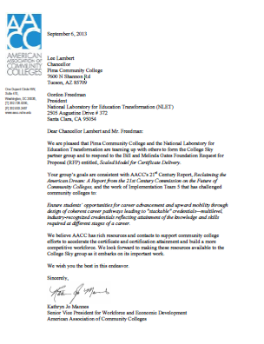
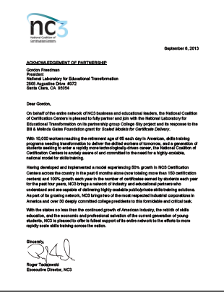
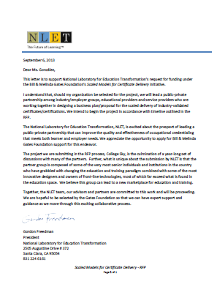
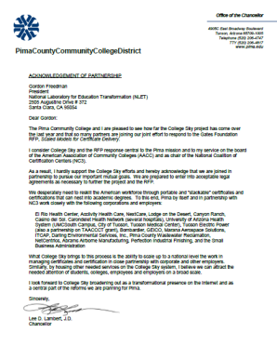
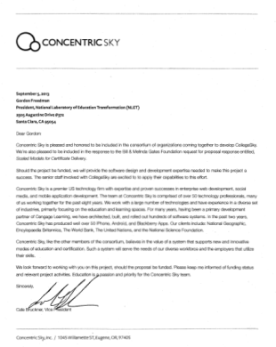
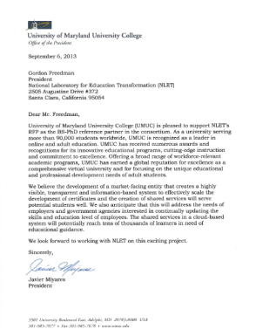
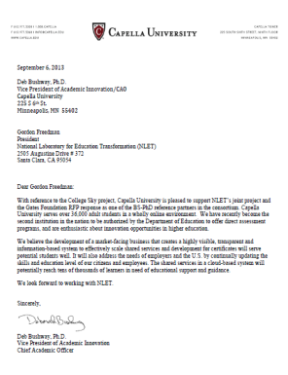
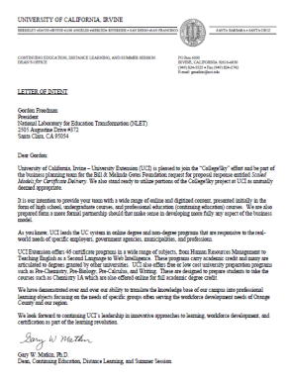
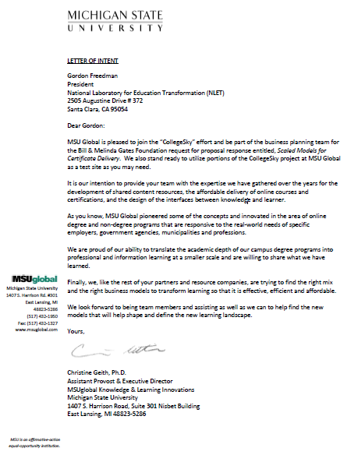
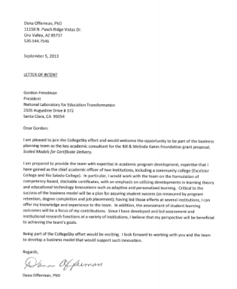
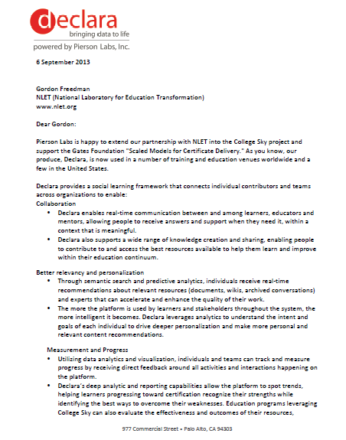
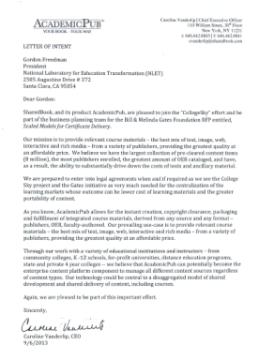
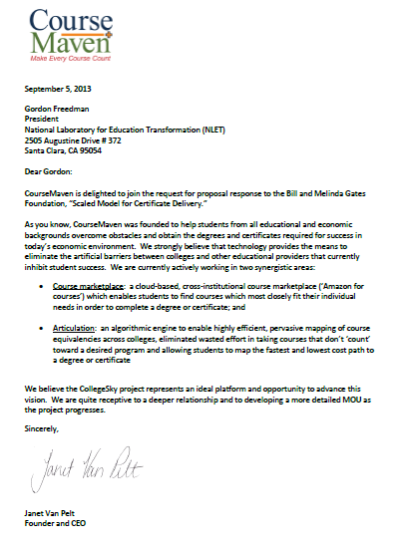
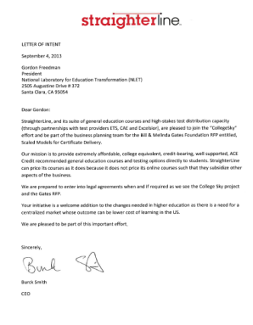
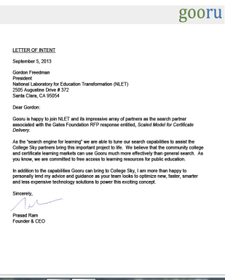
CollegeSKY
CollegeSky.com Partners, Providers, Resources
Partners
Providers
Resources

Slide 17
CollegeSKY
CollegeSky.com
Learner Identity System
Transcripts & Evidence
Provider & Service Registry
Certificates & Certifications
CENTRAL MATCHING TRANSCRIBING
TRACKING TECHNOLOGY & DATA SYSTEM
Job Registry & Trend Reporting
Available & Trending Openings
Higher Education Degrees
eProviders, Accept Certificates

Slide 18

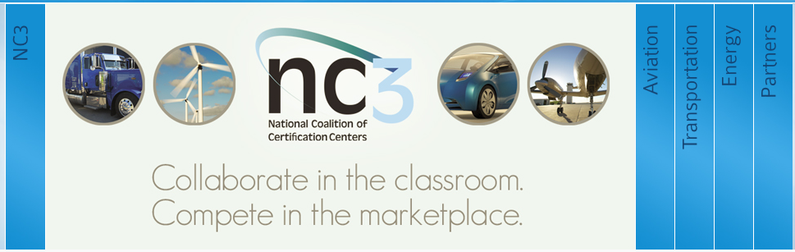
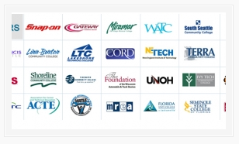
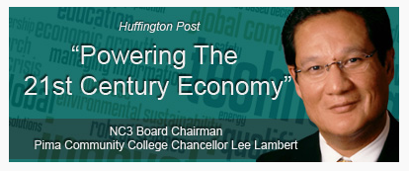
CollegeSKY
CollegeSky.com
The National Coalition of Certification Centers (NC3) was established to address the need for strong industry partnerships with educational institutions in order to develop, implement and sustain industry-recognized portable certifications that have strong validation and assessment standards.
Certification / Corporate Connection

Slide 19

CollegeSKY
CollegeSky.com
Learner Identity System
Transcripts & Evidence
Provider & Service Registry
Certificates & Certifications
Job Registry & Trend Reporting
Available & Trending Openings
Higher Education Degrees
eProviders, Accept Certificates

Slide 20

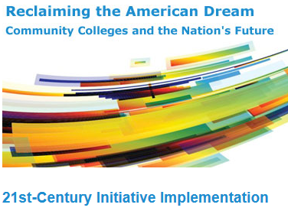



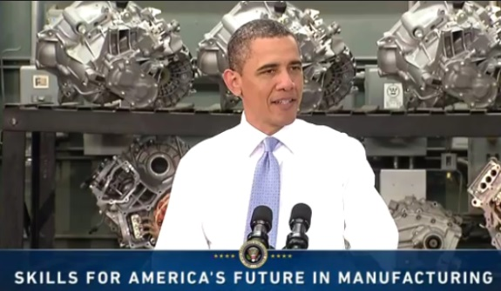
CollegeSky.com
Ensure students’ opportunities for career advancement and upward mobility through design of coherent career pathways leading to "stackable" credentials—multilevel, industry-recognized credentials reflecting attainment of the knowledge and skills required at different stages of a career.
This National Concern Needs a Full Response from the Best in the U.S.

Slide 21
CollegeSKY
CollegeSky.com
Learner Identity System
Transcripts & Evidence
Provider & Service Registry
Certificates & Certifications
To Be Developed
Job Registry & Trend Reporting
Available & Trending Openings
Higher Education Degrees
eProviders, Accept Certificates

Slide 22
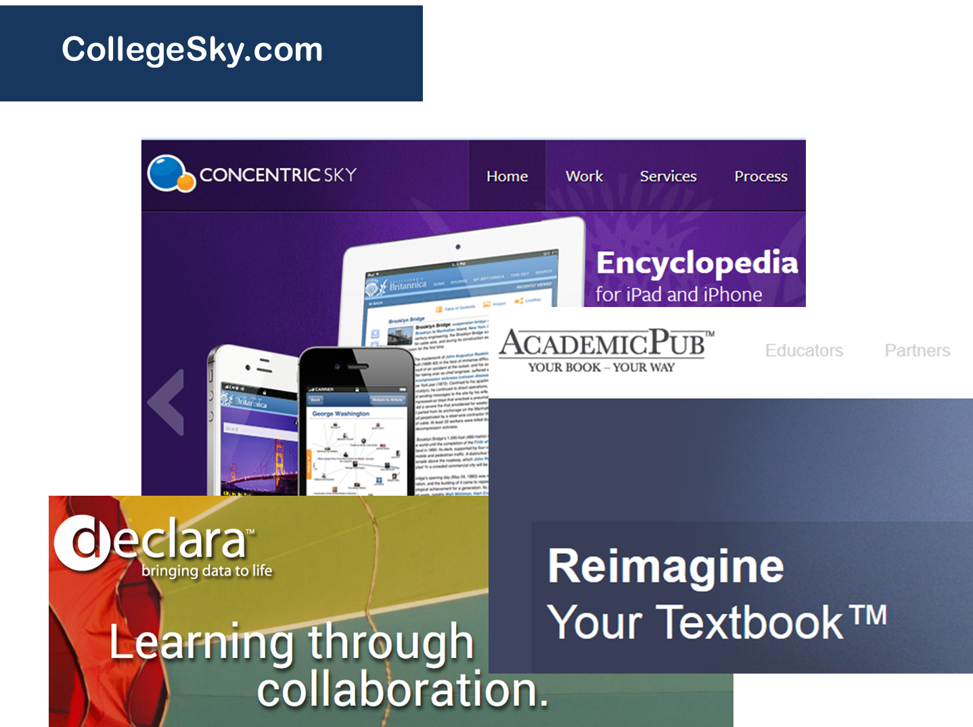


CollegeSKY
Using High-Grade Web Technologies

